Slide 1

Project 4 Demo 2
Alicia Smith | A00267161

Slide 2
Project Overview: Android App to retrieve Spotify song recommendations based on user’s top songs from listening history
Recap
(Demo 1)
Tools: Spotify API, Python, mysql, firebase, Xamarin, unity, arcore
Suggestions from demo 1: -Investigate use of machine learning to generate recommendations -Streamline user stories and focus on main features-features
-

Slide 3
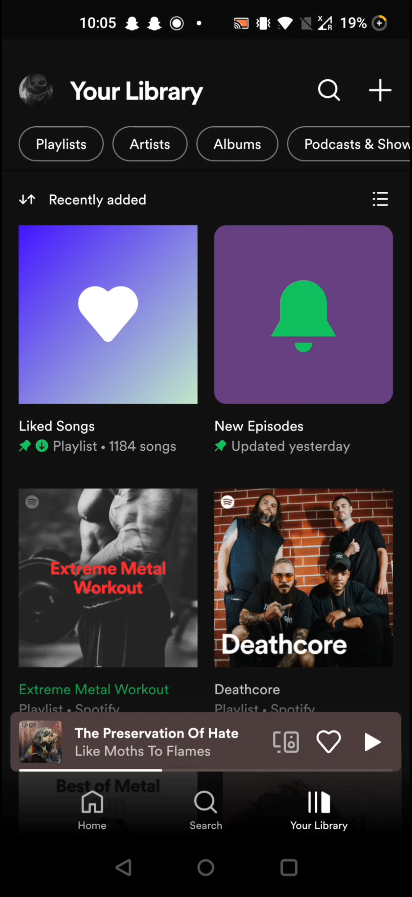
Progress
As music listener I want to see my top played artists So I can gain insight into my listening history | Done
As music listener I want to see my top played tracks So I can gain insight into my listening history | Done
As music listener I want to add my top tracks to a playlist So I can listen to my favourite song | Done (temporary for demo purposes today)
As music listener I want to get recommendations from someone’s listening history So I can listen to similar music | Done
As music listener I want to save recommendations to a playlist So I can listen to them in Spotify | Done

Slide 4





Feature Changes
AR Integration – beyond the scope of this project within the given timeframe
GeoFire - beyond the scope of this project within the given timeframe
Data Visualisation – increased importance of visualization for track audio features and listening trends
Profile Functionality - prioritizing a functioning prototype over a more interactive registration system
Frontend – using Android Studio (Java) rather than Xamarin (C#)

Slide 5
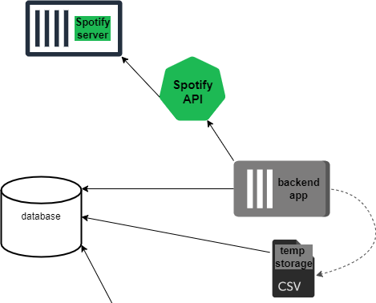
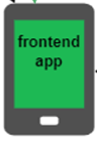
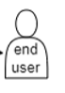
Architecture
JSON

Slide 6
The Plan
February (28th)
Registration and Login (Spotify Authentication)
Integrate Database (Firebase)
March (7TH)
Data Visualisation of Audio Features
Frontend Profile – display account details and statistics
March (14TH)
Integrate frontend and backend
Have demo working with other users
March (21st)
Data visualisation drilldowns for genres
March (28th)
Clean up frontend with non-functional features
April(4th)
Outstanding features
April (11th)
Project & Thesis submission

